Slide 1
Deep Bayesian Image Set Classification: A Defence Approach against Adversarial Attacks
N. Mirnateghi and S. Shah, Murdoch University, Perth, Australia.
M. Bennamoun , University of Western Australia, Crawley, WA, Australia
Reported by : 郑雅洲，王宝娟

Slide 2
1. Introduction
2. Method
3. Experiments
4. Conclusion

Slide 3
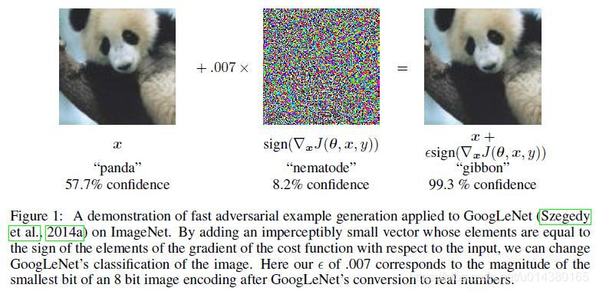
Introduction

Slide 4
Introduction
1. An approach based on image set classification for defence against adversarial attacks.
2. Deep Bayesian Neural Network.
3. Voting strategies.

Slide 5
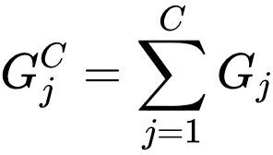
Method
An image set :
A gallery :
Total number of galleries :
The total number of images in each Gallery :

Slide 6
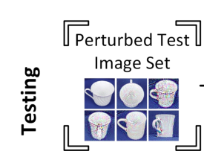
Method
Training: Clean + Perturbed images
Testing： Perturbed images
: % of perturbed images in

Slide 7
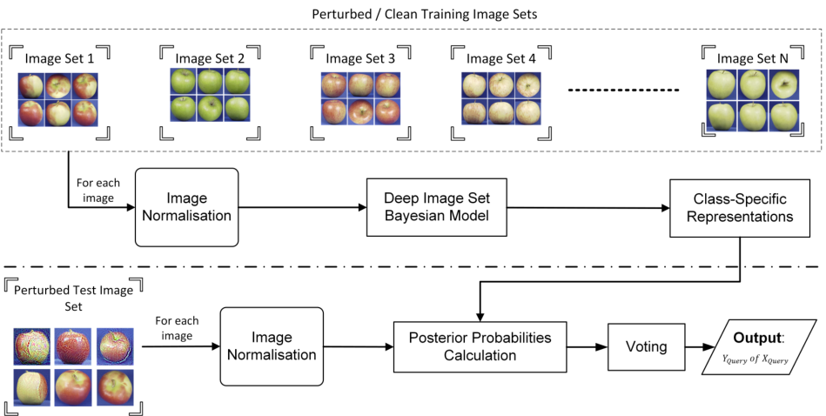
Method
Proposed Deep Bayesian Model:
Bayesian Deep Learning:
Based on Res-Net50, adding a dropout layer of 0.5 after the last activation layer and before the last FC layer, to collect a sample of Monte Carlo estimates at training and testing stage.
Voting Strategies：

Slide 8
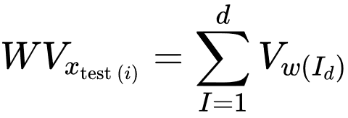
Method
Voting Strategies:
Majority Vote:
Soft Vote:
Exponential Weighted Vote:

Slide 9
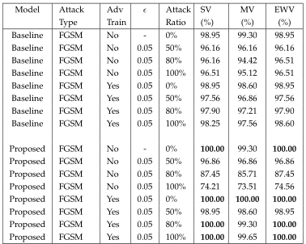
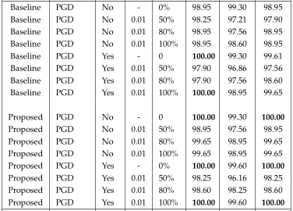
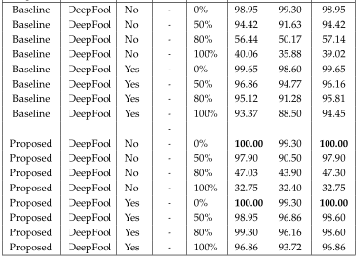
Experiments

Slide 10
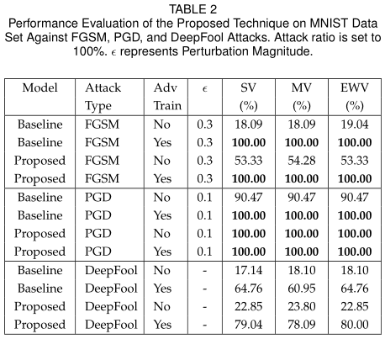
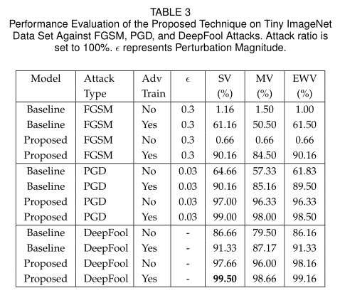
Experiments

Slide 11
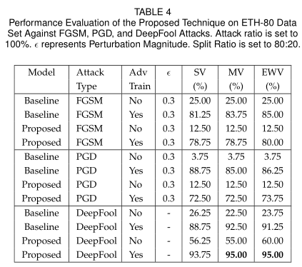
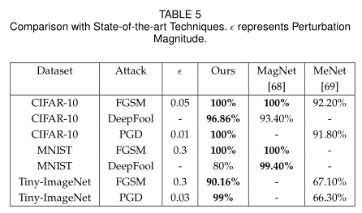
Experiments
Ablative study:

Slide 12
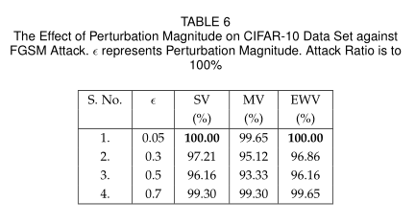
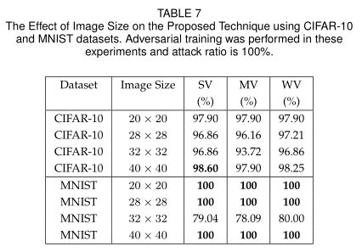
Experiments
Ablative study:

Slide 13
Conclusion
The proposed image set classification technique achieves the state-of-the-art performance on benchmark datasets against iterative and non-iterative adversarial attacks. We also showed that the proposed image set classification technique can be applied on any object recognition
tasks by modifying the training data. The proposed technique can be used as a potential defence mechanism against adversarial examples in the physical world.

Slide 14
THANKS!

